Slide 1

Speed of Search Algorithms
Soumyadeep Das
Springhouse Middle School
Mr. Bauer
Notes:
Good morning, I am Soumyadeep Das from Springhouse Middle School and today I will present my presentation on search algorithms.

Slide 2

Problem Statement
What is the fastest graph-searching algorithm?
Notes:
My problem statement is, “What is the fastest graph-searching algorithm?”

Slide 3
Why The researcher chose this project & Benefits
The researcher chose this project due to his interest in computer science. He has been coding since he was 8, and finding out about how GPSs work simply amazed him. This project will benefit many people, as many people use a wide variety of GPSs to commute from place to place, such as to work. Improvement to these algorithms will help everyone.
Notes:
I chose this project due to my interest in computer science. I was coding since I was 8, and since that time, GPSs simply amazed me. This project will benefit everyone who use GPS to commute to different places.

Slide 4
Background Information (TERMS)
Algorithm: A process or set of rules to be followed in calculations or other problem-solving operations, especially by a computer.
Python: an interpreted, object-oriented, high-level programming language
Algorithmic Complexity: a measure of how long an algorithm would take to complete given an input of size n
Graph (graph theory): models pairwise relations between objects/nodes.
Graph Traversal: process of visiting (or checking) each node in a graph
Leaf node: node with no children/successors
A*: the “gold standard” of shortest path finding. Used by Google Maps to find routes.
Big O Notation: notation used for complexity which drops all coefficients
Informed/Uninformed Search: Algorithm which does/doesn’t use a heuristic.
Heuristic: Technique designed for solving a problem more quickly when classic methods are invalid/too slow
Notes:
Read Terms; “Graphs in graph theory”,

Slide 5
Background Information (Algorithms)
Algorithms used:
A*
Bidirectional
BFS
Dijkstra’s
DFS
Greedy Best-First Search
Ant Colony Optimization (removed)
IDA* (removed)
Ant Colony Optimization and IDA* were removed.
Ant Colony Optimization couldn’t find a correct path.
IDA* used recursion.
In Python, the max recursion limit is 1000 (for a good reason). When the graph has almost that number or above, Python crashes. (This is to prevent Python from using up infinite RAM).
Notes:
I used (algorithms used) in my project, but decided two remove two of them.
ACO couldn’t find a correct path.
IDA* used a lot of recursion, but Python places limit to keep a computer from crashing.

Slide 6
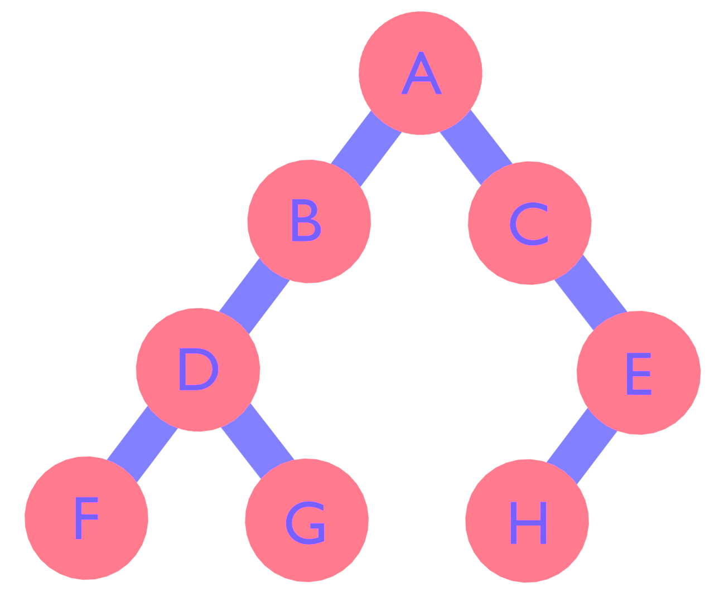
Background Information (TERMS)
Depth-First Search (DFS, recursive):
Starts at node N, go up 1 level if it’s a leaf node. Then run DFS on all the child nodes. This causes DFS to go all the way to the bottom of the tree before going to the next sibling.
Breadth-First Search (BFS):
Create a queue that has the source node. Pop the first node from the queue and add its successors into the queue. Repeat while destination isn’t found, or queue still has elements. This causes BFS to finish the first layer before going onto the next layer in a tree.
Notes:
DFS goes down one layer, unless if it’s a leaf node. This causes DFS to go all the way down before going to the next sibling.
BFS goes layer by layer, going to A then B&C then D&E then F,G&H.

Slide 7

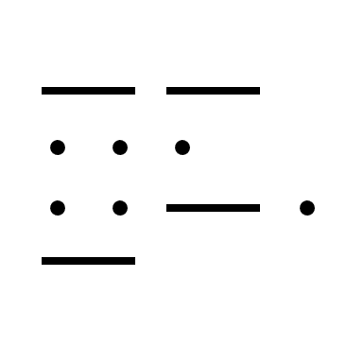
Background Information (Variables)
Variables:
Independent:
Sorting Algorithm
Dependent:
Time taken
Cost of the path
Constants:
Graph used for each trial.
Notes:
There is two dependent variables being recorded, but only 1 will be used to accept/reject the hypothesis.

Slide 8
Hypothesis Statement
If the researcher searched for the shortest path between two randomly chosen nodes, BFS will have the fastest time compared to any other search algorithm.
According to research, BFS has an algorithmic complexity of O(V+E), which is better than Dijkstra’s and Bidirectional. BFS also doesn’t use a costly heuristic, which Greedy and A* use. Also, since there are many nodes and barely any leaf nodes, BFS is more likely to outcompete DFS.
Notes:
If I searched for the shortest path between two randomly chosen nodes on a randomly created graph, BFS would have the fastest time. According to research, BFS has an algorithmic complexity better than Dijkstra’s and Bidirectional. BFS doesn’t use a heuristic either, making it faster than Greedy and A*. Since there are barely any leaf nodes, DFS will most likely be slower than BFS.

Slide 9
Materials
The code was altered to be compatible with how I stored my graphs.
A* search, www.geeksforgeeks.org/a-search-algorithm/
Bidirectional search, www.geeksforgeeks.org/bidirectional-search/
BFS, www.geeksforgeeks.org/breadth-first-search-or-bfs-for-a-graph/
Dijkstra’s Algorithm, www.geeksforgeeks.org/dijkstras-shortest-path-algorithm-greedy-algo-7
DFS, www.geeksforgeeks.org/depth-first-search-or-dfs-for-a-graph/
Greedy Search, www.programiz.com/dsa/greedy-algorithm
Python 3 and required dependencies used in the algorithms
Notes:
My materials are the algorithms and Python 3 and the dependencies needed to run the algorithms.

Slide 10
Procedure
Generate random graph with 1024 random vertices on a 400x400 plane, where vertices within 24 length between them are connected.
Run algorithm on graph and measure time and cost. (-1 for invalid paths)
Repeat steps 2-3 for each algorithm
Dump data to csv (Not necessarily in this step)
Repeat steps 1-4 for each trial (36229 trials in total)
Calculate average times and costs for each algorithm in comparison to the A* cost for that trial
Create bar graph for each time and cost.
Notes:
The diagram on the next slide will explain why step 3 could sometimes be placed elsewhere.

Slide 11
High-Level Diagram
Produce Data
Save Data
Data
Data Array
Generate Graph
A*
Bidirectional
BFS
Dijkstra’s
DFS
Greedy
Storing more than 1000?
Move data to CSV
Record Time and Path Cost
Notes:
Explain “Save Data” Frame, Data Array RAM, CSV IO Processes

Slide 12
Time Comparison Chart
Notes:
Here you can see BFS is doing the best, with a time 3% that of A*. This was unexpected, but Dijkstra’s was 69% higher than A*.

Slide 13
Data Charts
Notes:
DFS has an extremely high path cost compared to A*.

Slide 14
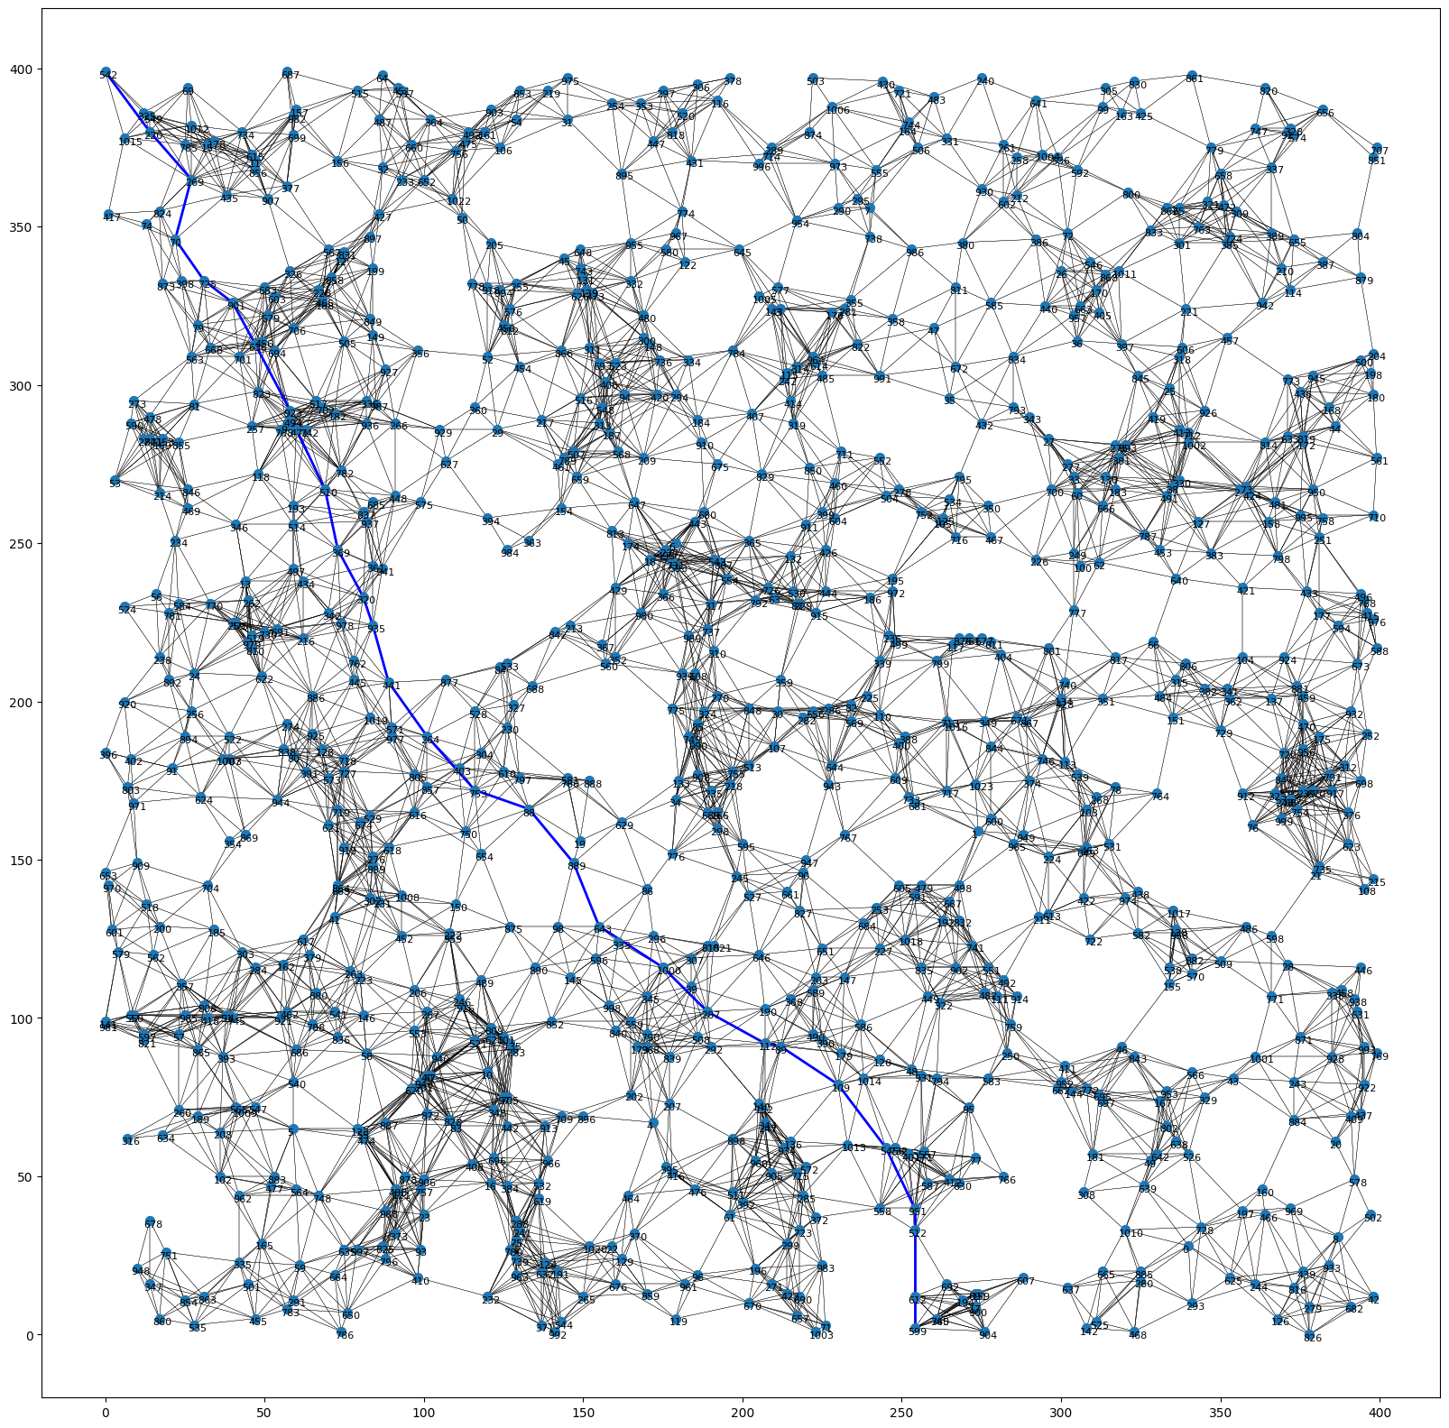
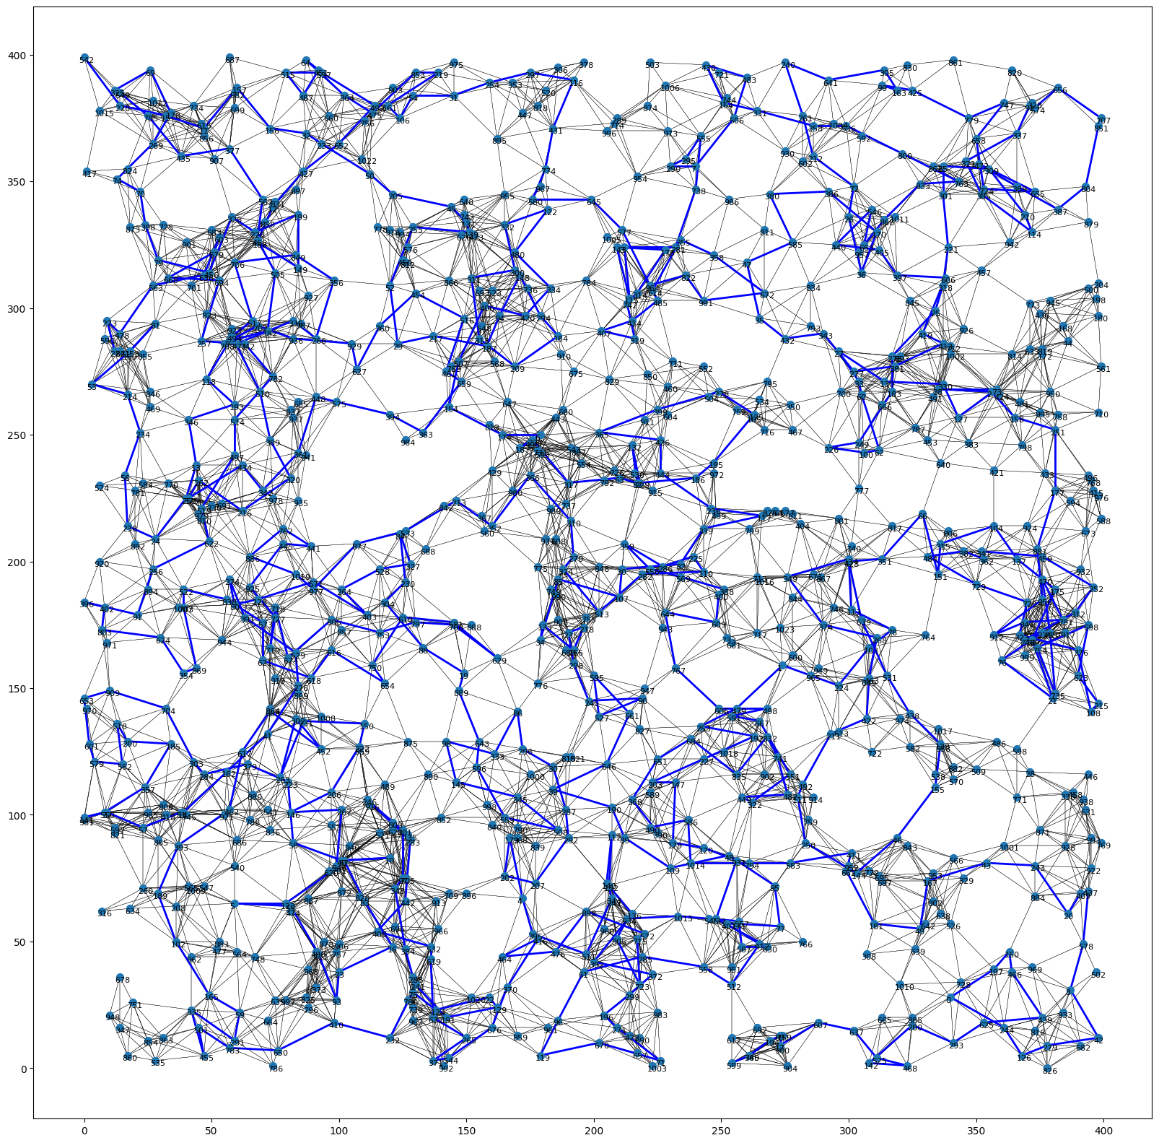
Example graphs
Start
A*
Start
DFS
End
End
Notes:
Here is a side-by-side comparison of A* and DFS. A* finds the best path as you can see on the left side. DFS however, finds a very suboptimal path. This explains the high value seen on the previous slide.

Slide 15
Conclusion
The research question was, “What is the fastest graph searching algorithm?”
The hypothesis was: If the researcher searched for the shortest path between two randomly chosen nodes, BFS will have the fastest time compared to any other search algorithm.
According to research, BFS has the best factors compared to the other algorithms, in time complexity and time needed to calculate the heuristic (which BFS doesn’t have).
Notes:
…According to research, BFS has the best factors compared to the other algorithms.

Slide 16
Conclusion
As seen in the normalized time comparison chart, BFS had a ratio of about 0.03:1 which is the lowest out of all the algorithms. The researcher’s hypothesis is supported by the data.
BFS doesn’t use heuristics, which makes it very fast. The heuristic for graph involves taking a square root, which is very costly.
BFS has the lowest complexity, of O(V+E)
Notes:
BFS had the lowest time, 3% of how long A* took. My hypothesis was supported by the data. Two reasons is because it doesn’t use heuristics and has a low complexity.

Slide 17
Conclusions
Errors:
One error is that since the code runs so fast, the times recorded may be off by some value. If this code is run on a device with less processing power (e.g., Raspberry Pi), those margins make less of an effect.
Choosing higher node counts is harder, because trial and error is required to get the minimum length that keeps all the nodes connected, but at the same time not connecting too many to create an easy path.
The algorithms were not optimized for peak performance.
Notes:
An error is that the times recorded were off by some amount. This can be compensated for by running this on a lower quality device, such as a Raspberry Pi, where the amounts make less of an effect. Simply cranking up the number of nodes won’t help either, as the minimum length must be properly chosen as well. The algorithms weren’t optimized either.

Slide 18
Conclusion
Pathfinding is very important in the area of AI. In this case, it is being used with physical paths, however there may be other items that are represented through graphs, such as a game tree, which is used in gamebots.
Google Maps, which is a very common application used to find routes to get from a source to a destination uses A*. Many other GPSs use A*.
Notes:
Shortest pathfinding is important in AI, as game states can also be represented through graphs. Gamebots, such as those which play chess use searching algorithms. Google Maps, a very popular application uses A* like many other GPSs.

Slide 19
Suggestions
One area for improvement is the coding language used. Interpreted languages are drastically slower than compiled languages due to how they are executed. Python is an interpreted language, and a great alternative is C++.
The only problem with C++ is how long it would take to develop the code. In Python it took about 10-15 hours, but in C++ it would likely 2-3x as much.
Notes:
The language used can play a big role in execution time. Compiled languages are much faster than interpreted languages. C++ is a great alternative; however, the development time is the only issue. Python took me about 10-15 hours to develop, but C++ would most likely take me 2-3 times as much.

Slide 20
Additional Links
GitHub Repo: https://github.com/python9160/science-fair-2223
main.py: https://github.com/python9160/science-fair-2223/blob/main/main.py
Notes:
Here is the link to my GitHub Repo.

Slide 21
Bibliography
Works Cited
Belwariar, Rachit. "A* Search Algorithm." GeeksforGeeks, Sandeep Jain, 30 May 2022, www.geeksforgeeks.org/a-search-algorithm/. Accessed 7 Feb. 2023.
Depth First Search or DFS for a Graph. Sandeep Jain, 26 Dec. 2022, www.geeksforgeeks.org/depth-first-search-or-dfs-for-a-graph/. Accessed 7 Feb. 2023.
GeeksforGeeks, and Divyanshu Mehta. "Dijkstra's Shortest Path Algorithm | Greedy Algo-7." Edited by Pranav Singh Sambyal. GeeksforGeeks, Sandeep Jain, 27 Jan. 2023, www.geeksforgeeks.org/dijkstras-shortest-path-algorithm-greedy-algo-7/. Accessed 7 Feb. 2023.
GeeksforGeeks, and Neelam Pandey. "Iterative Deepening Search(IDS) or Iterative Deepening Depth First Search(IDDFS)." GeeksforGeeks, Sandeep Jain, 26 July 2022, www.geeksforgeeks.org/iterative-deepening-searchids-iterative-deepening- depth-first-searchiddfs/. Accessed 7 Feb. 2023.
GeeksforGeeks, et al. "Breadth First Search or BFS for a Graph." GeeksforGeeks, Sandeep Jain, 19 Jan. 2023, www.geeksforgeeks.org/breadth-first-search-or-bfs-for-a-graph/. Accessed 7 Feb. 2023.
Kumar, Atul. "Bidirectional Search." GeeksforGeeks, Sandeep Jain, www.geeksforgeeks.org/bidirectional-search/.
PratikBasu. "Introduction to Ant Colony Optimization." GeeksforGeeks, Sandeep Jain, 17 May 2020, www.geeksforgeeks.org/introduction-to-ant-colony-optimization/. Accessed 7 Feb. 2023.
Programiz. "Greedy Algorithm." Programiz, edited by Ranjit Bhatta, www.programiz.com/dsa/greedy-algorithm. Accessed 7 Feb. 2023.
Notes:
Here is my Bibliography.

Slide 22
Thank you
Notes:
Thank you for your time! Do you have any questions?

